Slide 1

2026-27 BENEFITS REVIEW
Plan Year: May 1, 2026 – April 30, 2027
Notes:
Opening Slide. Meeting begins:

Slide 2







2026-27 Benefits Package
Plan Year: May 1, 2026 – April 30, 2027
RENEWAL
NEW
NEW
RENEWAL
RENEWAL
Medical
Dental
Vision
Life Insurance and Disability
Voluntary Benefits

Slide 3
When can you make changes to your plan?
During open enrollment or when a qualifying event occurs such as:
Marriage, divorce, or legal separation
Birth or adoption of a child
Change in spouse’s employment
Moving outside an HMO eligible area
Medical Child Support Order
Change in job status from full to part time
Loss of coverage from another group health plan

Slide 4

Complete by Friday, April 20, 2026

Slide 5


MEDICAL BENEFITS

Slide 6

HMO Medical Coverage
Medical
How it works
You choose a Primary Care Physician (PCP) for each family member.
You pay a copay or coinsurance for doctors’ visits and services performed during visits.
You pay a copay or coinsurance for most other services, such as outpatient surgery, hospital care or specialized tests.
Once you reach the annual out of pocket maximum, the plan pays 100% of any remaining covered expenses, including copays.
PROS:
Many costs are predictable
Your out-of-pocket costs are typically lower when you use in-network care
CONS:
No out-of-network benefits
Referrals needed to see specialists
More limited choice of doctors and facilities

Slide 7
Kaiser Permanente HMO Options
Plan | Low | Mid | High
Deductible | $1,500 | $750 | $0
Out of Pocket Maximum | $4,000 | $3,000 | $3,000
Office Visits | $40/$50 | $30/$40 | $30/$40
Hospital | 30%* | 20%* | $500 per day ($1,500 per admit)
Emergency Room | 30%* | 20%* | $250
Chiropractic | $15 30 visits per year | $15 30 visits per year | $15 30 visits per year
Prescriptions | $10/$30/$30 | $10/$30/$30 | $15/$35/$35
Cost | $ | $$ | $$$

Slide 8


Slide 9


Slide 10


Slide 11


Slide 12
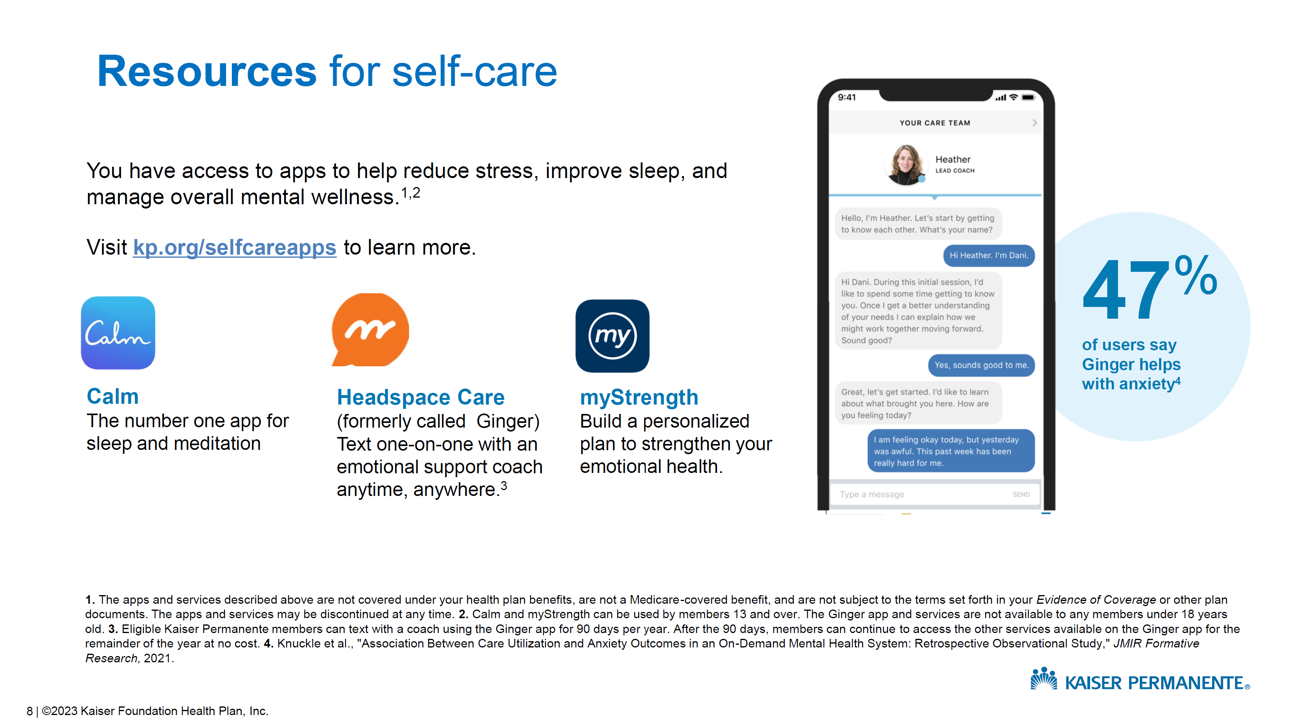

Slide 13

DENTAL BENEFITS

Slide 14
DENTAL PPO Benefit Highlights
Annual Maximum Benefit $2,500 per person
Large, nationwide dental network
Cleanings covered at 100%

Slide 15
DENTAL PPO Benefit Summary
 | PPO
Deductible | $50 3/fam
Annual Benefit Maximum | $2,500
Preventive Care | 100%
Basic Services | 80%
Major Services | 50%
Orthodontia (Adult and Child) | 50% to $1,500 lifetime maximum

Slide 16
DENTAL HMO Benefit Highlights
Annual Maximum Benefit
Unlimited
Negotiated discounts from network dentists
Cleanings covered at 100%

Slide 17

VISION BENEFITS

Slide 18



VISION Benefit Highlights
$10 cost eye exams (every 12 months)
Frames frequency – one set every 24 months
$150 frame allowance on vision + 20% discount
National retailers included in network

Slide 19


Life Insurance

Slide 20
Basic Life Insurance Benefit Highlights
Sponsored by employer 100%
1x annual salary up to $50,000
Guaranteed-issue

Slide 21
Voluntary Life Insurance Benefit Highlights
Voluntary Life Insurance
5x annual salary, up to $500,000
Guaranteed Issue
$100,000 for employee
$50,000 for spouse
$25,000 for child
Annual Benefit Amount Increase

Slide 22

Disability Insurance

Slide 23
YOUR SHORT TERM DISABILITY BENEFITS
Short-Term Disability (STD)
Covers first 25 Weeks (after 7/7 day elimination period)
SHORT-TERM DISABILITY
Mutual of Omaha provides income protection for disabilities that occur due to injury or sickness and last for a short period of time.
 | All Eligible CA Employees
Benefit Amount | 60% of Weekly Earnings
When are Benefits Payable? | On the 8th day of your disabling injury On the 8th day of your disabling illness
Maximum Benefit | $1,000 per Week
Maximum Duration | 25 Weeks
DID YOU KNOW?
- The average SSDI benefit is $1,234/month - Applying for SSDI is a difficult process, normally takes 2 - 3 years to be approved - 2,000,000 people apply for SSDI each year; about 700,000 (35%) are approved

Slide 24
YOUR LONG TERM DISABILITY BENEFITS
Long-Term Disability
After SHORT-TERM DISABILITY (180 days) Up to SSNRA
LONG-TERM DISABILITY-
Mutual of Omaha provides income protection against a long-term in injury or sickness that extends beyond the period covered by short-term disability plan.
Benefit Amount | 60% of Monthly Earnings
When are Benefits Payable? | Your benefits begin on the later of 180 calendar days after the onset of your disabling injury or illness or the date your STD ends
Maximum Benefit | $6,000 per Month
Maximum Duration | SSNRA
DID YOU ALSO KNOW?
- A 20-year-old has a 25% chance of missing a full year of work due to injury/illness - A 35-year-old male has a 50% chance of becoming disabled before age 65 - One year of total disability could wipe out 10 years of your life’s savings - Over 375,000 Americans become totally disabled every year.

Slide 25

Accident, Critical Illness and Hospital

Slide 26
Voluntary Accident Benefit Highlights
Benefit Category | Coverage Amount
Emergency Room | $200
Urgent Care | $125
Fractures | Up to $6,000
Dislocation | Up to $9,000
Hospital Admission | $1,500
Follow-Up care | $75 up to 6 per accident

Slide 27
Voluntary Critical Illness Benefit Highlights
Benefit Category | Condition | % of CI Principal Sum
Heart/Circulatory/Motor Function | Heart Attack, Heart Transplant, Stroke, ALS(Lou Gehrig’s), Advanced Alzheimer’s, Advance Parkinson’s Heart Valve Surgery, Coronary Artery Bypass, Aortic Surgery | 100% 25%
Organs | Major Organ Transplant/Placement on UNOS List, End-Stage renal Failure Acute Respiratory Distress Syndrome (ARDS) | 100% 25%
Childhood/Developmental | Cerebral Palsy, Structural Congenital Defects, Genetic Disorders, Congenital Metabolic Disorders, Type 1 Diabetes | 100%
Cancer | Cancer (Invasive) Bone Marrow Transplant Carcinoma in Situ, Benign Brain Tumor | 100% 50% 25%

Slide 28
Hospital Indemnity Benefit Highlights
Benefit Category | Coverage Amount
Hospital Admission | $1,000 per admission
Daily Hospital Confinement | $100 per day
ICU Admission | $2,000 per admission
Daily ICE Confinement | $200 per day
Daily Newborn Nursery Care Confinement | $75 per day

Slide 29
Employee Assistance Program (EAP)
Stress, Depression, Anxiety
Relationship Issues, divorce
Job stress, work conflicts
Child care
Elder care
Legal questions
Financial Services

Slide 30


Flexible Spending Account (FSA)

Slide 31

Annual contribution limit
2026 Medical FSA maximum:
$3,400
Contribute and spend funds tax-free
Pay for eligible out-of-pocket healthcare expenses
Notes:
The IRS sets the maximum dollar amount you can elect and contribute to a Flexible Spending Account (FSA) and Dependent Care FSA.
The 2024 FSA annual contribution limit is: $3,20 0.
We recommend reviewing how much you spend on eligible expenses every year to determine how much to elect.
Once you elect an FSA, all of your FSA dollars are available for you to use the very first day of the plan year. For example, if you elect to contribute $1,200 to your FSA, your contributions will be deducted evenly across all of your paychecks for the year, but you have access to all $1,200 on day one! You can use your funds for expenses incurred by you, your spouse or eligible dependents.

Slide 32
Medical FSA grace period and run-out
May 1, 2026 – April 30, 2027
July 15, 2027 - Deadline to incur claims.
July 31, 2027 - Deadline to submit claims.
Notes:
(Remove slide if there is NO grace period)
Your plan year runs from January 1st to December 31st 2024 and your company offers a grace period, which means you have until March 15, 2025 to incur services.
March 31st of 2025 is your run out date, which means you have until this date to submit all paperwork for claims incurred during the plan year and grace period.

Slide 33

Annual contribution limit
2026 dependent care FSA maximum:
$7,500 per household
$3,750 per person (if married or filing separately)
Contribute and spend funds tax-free
Pay for qualified dependent care expenses
Recurring Dependent Care Form
Notes:
Your dependent care FSA can be used to pay for out-of-pocket daycare expenses, after-school programs, and day camp programs for dependents up to the age of 13. It also covers costs for disabled spouse or dependents of any age.
Your household can elect up to $5,000 annually through the Dependent Care FSA.
A household can be a single adult electing $5,000 or if you are married or have a domestic partner and elect $5,000 total together as a household.
If you are married but filing separately your total annual election can still not exceed $5,000.
You can contribute dollars to your dependent care FSA pre tax via your payroll dollars to help pay for qualified dependent care expenses.
We do offer a Recurring Dependent Care Request Form that makes utilizing your dependent care dollars really easy. Simply fill out the form once, submit it to WEX and if approved we will reimburse you every time you contribute to your dependent care account.

Slide 34

QUESTIONS?

